Slide 1
Intro to Cryptography
CS 161 Fall 2022 - Lecture 5

Slide 2
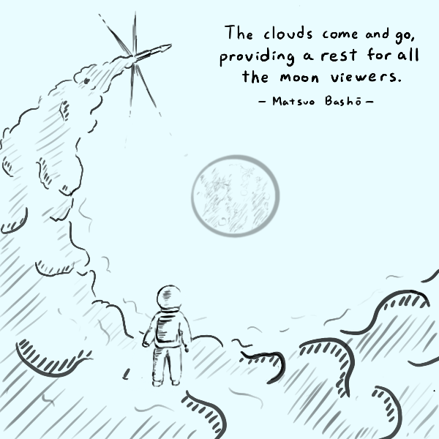
Announcements
See calendar for latest OH schedule
Notes:
Want to submit an announcements doodle? Email evanbot@berkeley.edu or post on Piazza!

Slide 3
Cunning Plan Today: Cryptography
Introduction to Cryptography
What is cryptography?
Definitions
A brief history of cryptography
IND-CPA security
One-time pads

Slide 4
What is cryptography?
Textbook Chapter 5.1
Notes:
https://twitter.com/SwiftOnSecurity/status/832055497251487744

Slide 5
What is cryptography?
Older definition: The study of secure communication over insecure channels
Newer definition: Provide rigorous guarantees on the security of data and computation in the presence of an attacker
Not just confidentiality but also integrity and authenticity (we’ll see these definitions today)
Modern cryptography involves a lot of math

Slide 6


Don’t try this at home!
We will teach you the basic building blocks of cryptography, but you should never try to write your own cryptographic algorithms
It’s very easy to make a mistake that makes your code insecure
Lots of tricky edge cases that we won't cover
One small bug could compromise the security of your code
Instead, use existing well-vetted cryptographic libraries
This portion of the class is as much about making you a good consumer of cryptography
 | Link
 | February 15, 2017
Cryptography is nightmare magic math that cares what kind of pen you use.
Notes:
TODO Nick

Slide 7
Don’t try this at home!
In summer 2020, CS 61A wrote a program to distribute online exams
However, when writing cryptographic code, they used a secure algorithm in an insecure way
Because of their mistake, it was possible to see exam questions before they were released!
Later in the semester, you’ll get to try and break their insecure scheme yourself
Exam leakage was reported, but we never found out if anyone actually attacked the insecure scheme
The TAs who wrote this code were former CS 161 students!
Takeaway: Do not write your own crypto code!
Notes:
TODO Nick

Slide 8
Definitions
Textbook Chapter 5.3–5.9

Slide 9
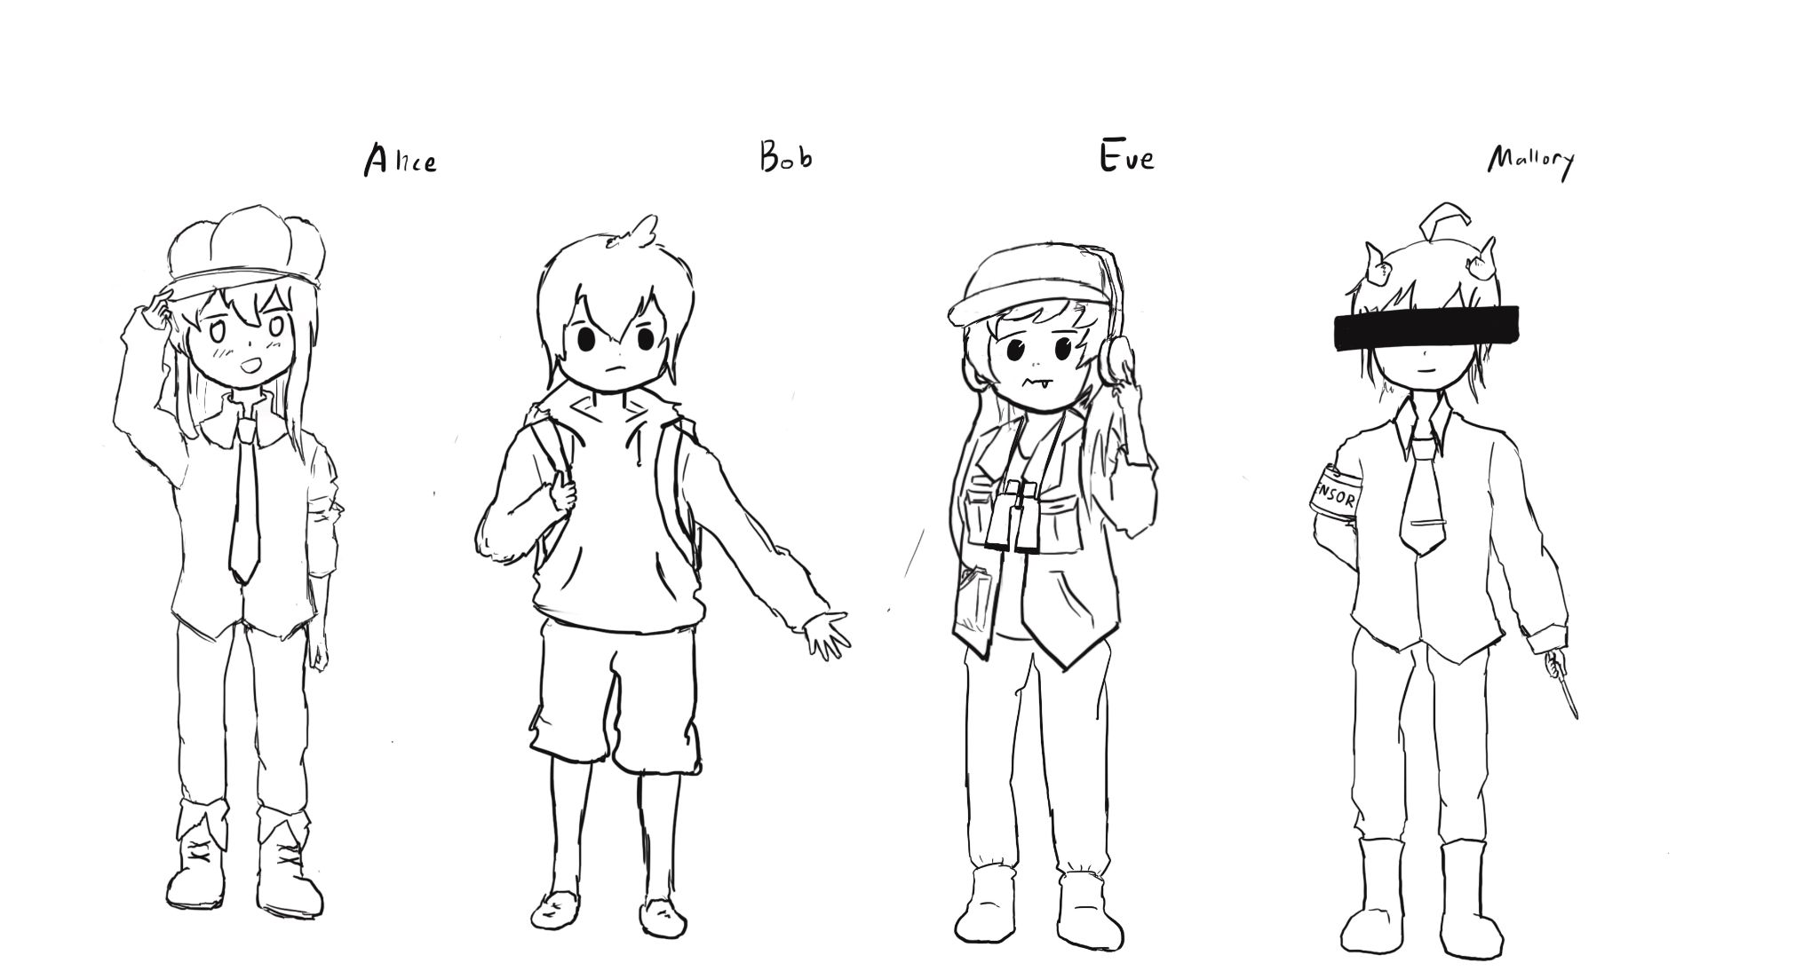
Meet Alice, Bob, Eve, and Mallory
Alice and Bob: The main characters trying to send messages to each other over an insecure communication channel
Carol and Dave can also join the party later
Eve: An eavesdropper who can read any data sent over the channel
Mallory: A manipulator who can read and modify any data sent over the channel

Slide 10
Meet Alice, Bob, Eve, and Mallory
We often describe cryptographic problems using a common cast of characters
One scenario:
Alice wants to send a message to Bob.
However, Eve is going to eavesdrop on the communication channel.
How does Alice send the message to Bob without Eve learning about the message?
Another scenario:
Bob wants to send a message to Alice.
However, Mallory is going to tamper with the communication channel.
How does Bob send the message to Alice without Mallory changing the message?

Slide 11
Three Goals of Cryptography
In cryptography, there are three main properties that we want on our data
Confidentiality: An adversary cannot read our messages.
Integrity: An adversary cannot change our messages without being detected.
Authenticity: I can prove that this message came from the person who claims to have written it.
Integrity and authenticity are closely related properties…
Before I can prove that a message came from a certain person, I have to prove that the message wasn’t changed!
… but they’re not identical properties
Later we’ll see some edge cases

Slide 12
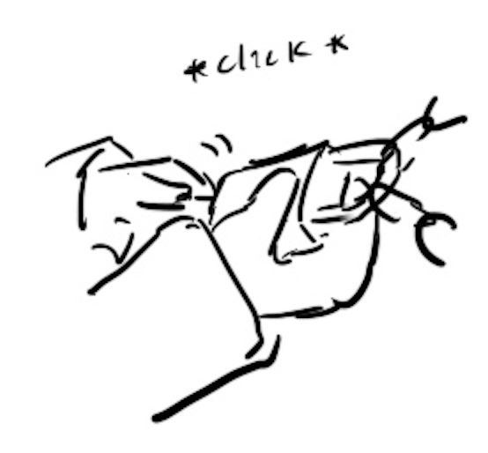
Keys
The most basic building block of any cryptographic scheme: The key
We can use the key in our algorithms to secure messages
Two models of keys:
Symmetric key model: Alice and Bob both know the value of the same secret key.
Asymmetric key model: Everybody has two keys, a secret key and a public key.
Example: You might remember RSA encryption from CS 70

Slide 13
Security Principle: Kerckhoff’s Principle
This principle is closely related to Shannon’s Maxim
Don’t use security through obscurity. Assume the attacker knows the system.
Kerckhoff’s principle says:
Cryptosystems should remain secure even when the attacker knows all internal details of the system
The key should be the only thing that must be kept secret
The system should be designed to make it easy to change keys that are leaked (or suspected to be leaked)
If your secrets are leaked, it is usually a lot easier to change the key than to replace every instance of the running software
Our assumption: The attacker knows all the algorithms we use. The only information the attacker is missing is the secret key(s).

Slide 14
Confidentiality
Confidentiality: An adversary cannot read our messages.
Analogy: Locking and unlocking the message
Alice uses the key to lock the message in a box
Alice sends the message (locked in the box) over the insecure channel
Eve sees the locked box, but cannot access the message without the key
Bob receives the message (locked in the box) and uses the key to unlock the message
Alice
Key
Insecure Channel
Key
Bob
Message
Lock
Message in locked box
Unlock
Message

Slide 15
Confidentiality
Schemes provide confidentiality by encrypting messages
Alice uses the key to encrypt the message: Change the message into a scrambled form
Alice sends the encrypted message over the insecure channel
Eve sees the encrypted message, but cannot figure out the original message without the key
Bob receives the encrypted message and uses the key to decrypt the message back into its original form
Alice
Key
Insecure Channel
Key
Bob
Message
Encryption Algorithm
Encrypted Message
Decryption Algorithm
Message

Slide 16
Confidentiality
Plaintext: The original message
Ciphertext: The encrypted message
Alice
Key
Insecure Channel
Key
Bob
Plaintext
Encryption Algorithm
Ciphertext
Decryption Algorithm
Plaintext

Slide 17
Integrity (and Authenticity)
Integrity: An adversary cannot change our messages without being detected.
Analogy: Adding a seal on the message
Alice uses the key to add a special seal on the message (e.g. puts tape on the envelope)
Alice sends the message and the seal over the insecure channel
If Mallory tampers with the message, she’ll break the seal (e.g. break the tape on the envelope)
Without the key, Mallory cannot create her own seal
Bob receives the message and the seal and checks that the seal has not been broken
Alice
Key
Insecure Channel
Key
Bob
Message
Create Seal
Message
Check Seal
Message
Seal

Slide 18
Integrity (and Authenticity)
Schemes provide integrity by adding a tag or signature on messages
Alice uses the key to generate a special tag for the message
Alice sends the message and the tag over the insecure channel
If Mallory tampers with the message, the tag will no longer be valid
Bob receives the message and the tag and checks that the tag is still valid
More on integrity in a future lecture
Alice
Key
Insecure Channel
Key
Bob
Message
Create Tag
Message
Check Tag
Message
Tag

Slide 19
Threat Models
What if Eve can do more than eavesdrop?
Real-world schemes are often vulnerable to more sophisticated attackers, so cryptographers have created more sophisticated threat models too
Some threat models for analyzing confidentiality:
 | Can Eve trick Alice into encrypting messages of Eve’s choosing? | Can Eve trick Bob into decrypting messages of Eve’s choosing?
Ciphertext-only | No | No
Chosen-plaintext | Yes | No
Chosen-ciphertext | No | Yes
Chosen plaintext-ciphertext | Yes | Yes

Slide 20
Threat Models
In this class, we’ll use the chosen plaintext attack model
In practice, cryptographers use the chosen plaintext-ciphertext model
It’s the most powerful
It can actually be defended against
 | Can Eve trick Alice into encrypting messages of Eve’s choosing? | Can Eve trick Bob into decrypting messages of Eve’s choosing?
Ciphertext-only | No | No
Chosen-plaintext | Yes | No
Chosen-ciphertext | No | Yes
Chosen plaintext-ciphertext | Yes | Yes

Slide 21
Cryptography Roadmap
 | Symmetric-key | Asymmetric-key
Confidentiality | One-time pads Block ciphers with chaining modes (e.g. AES-CBC) Stream ciphers | RSA encryption ElGamal encryption
Integrity, Authentication | MACs (e.g. HMAC) | Digital signatures (e.g. RSA signatures)
Hash functions
Pseudorandom number generators
Public key exchange (e.g. Diffie-Hellman)
Key management (certificates)
Password management

Slide 22

Symmetric-Key Encryption

Slide 23
Cryptography Roadmap
 | Symmetric-key | Asymmetric-key
Confidentiality | One-time pads Block ciphers with chaining modes (e.g. AES-CBC) Stream ciphers | RSA encryption ElGamal encryption
Integrity, Authentication | MACs (e.g. HMAC) | Digital signatures (e.g. RSA signatures)
Hash functions
Pseudorandom number generators
Public key exchange (e.g. Diffie-Hellman)
Key management (certificates)
Password management

Slide 24
Symmetric-Key Encryption
The next few schemes are symmetric-key encryption schemes
Encryption schemes aim to provide confidentiality (but not integrity or authentication)
Symmetric-key means Alice and Bob share the same secret key that the attacker doesn’t know
Don’t worry about how Alice and Bob share the key for now
For modern schemes, we’re going to assume that messages are bitstrings
Bitstring: A sequence of bits (0 or 1), e.g. 11010101001001010
Text, images, etc. can usually be converted into bitstrings before encryption, so bitstrings are a useful abstraction. After all, everything in a computer is just a sequence of bits!

Slide 25
Symmetric-Key Encryption: Definition
A symmetric-key encryption scheme has three algorithms:
KeyGen() → K: Generate a key K
Enc(K, M) → C: Encrypt a plaintext M using the key K to produce ciphertext C
Dec(K, C) → M: Decrypt a ciphertext C using the key K
Alice
Key
Insecure Channel
Key
Bob
Plaintext
Encryption Algorithm
Ciphertext
Decryption Algorithm
Plaintext

Slide 26
Symmetric-Key Encryption: Definition
What properties do we want from a symmetric encryption scheme?
Correctness: Decrypting a ciphertext should result in the message that was originally encrypted
Dec(K, Enc(K, M)) = M for all K ← KeyGen() and M
Efficiency: Encryption/decryption algorithms should be fast: >1 Gbps on a standard computer
Security: Confidentiality
Alice
Key
Insecure Channel
Key
Bob
Plaintext
Encryption Algorithm
Ciphertext
Decryption Algorithm
Plaintext

Slide 27
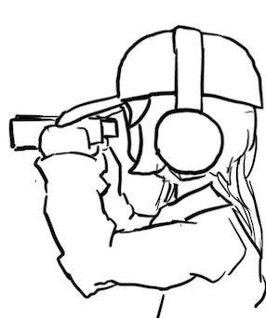
Defining Confidentiality
Recall our definition of confidentiality from earlier: “An adversary cannot read our messages”
This definition isn’t very specific
What if Eve can read the first half of Alice’s message, but not the second half?
What if Eve figures out that Alice’s message starts with “Dear Bob”?
This definition doesn’t account for prior knowledge
What if Eve already knew that Alice’s message ends in “Sincerely, Alice”?
What if Eve knows that Alice’s message is “BUY!” or “SELL” but doesn't know which?

Slide 28
Defining Confidentiality
A better definition of confidentiality: The ciphertext should not give the attacker any additional information about the plaintext.
Let's design an experiment/security game to test our definition:
Eve chooses two messages M0 and M1 of the same length
Alice chooses one message at random Mb, encrypts it, and sends the ciphertext
Eve knows either M0 or M1 was sent, but doesn't know which
Eve reads the ciphertext and tries to guess which message was sent
If the probability that Eve correctly guesses which message was sent is 1/2, then the encryption scheme is confidential
Intuition
If the scheme is confidential, Eve can only guess with probability 1/2, which is no different than if Eve hadn’t sent the ciphertext at all
In other words: the ciphertext gave Eve no additional information about which plaintext was sent!
Notes:
Shafi and Silvio won Turing award for probabilistic encryption, proving the need for randomization, laying foundations for modern cryptography and much stronger guarantees

Slide 29
Defining Confidentiality: IND-CPA
Recall our threat model: Eve can also perform a chosen plaintext attack
Eve can trick Alice into encrypting arbitrary messages of Eve's choice
We can adapt our experiment to account for this threat model
A better definition of confidentiality: Even if Eve is able to trick Alice into encrypting messages, Eve can still only guess what message Alice sent with probability 1/2.
This definition is called IND-CPA (indistinguishability under chosen plaintext attack)
Cryptographic properties are often defined in terms of “games” that an adversary can either “win” or “lose”
We will use one to define confidentiality precisely

Slide 30
Defining Confidentiality: IND-CPA
Eve (adversary)
Alice (challenger)
Eve may choose plaintexts to send to Alice and receives their ciphertexts
M
(repeat)
Enc(K, M)

Slide 31
Defining Confidentiality: IND-CPA
Eve (adversary)
Alice (challenger)
Eve may choose plaintexts to send to Alice and receives their ciphertexts
Eve issues a pair of plaintexts M0 and M1 to Alice
M
(repeat)
Enc(K, M)
M0 and M1

Slide 32
Defining Confidentiality: IND-CPA
Eve (adversary)
Alice (challenger)
Eve may choose plaintexts to send to Alice and receives their ciphertexts
Eve issues a pair of plaintexts M0 and M1 to Alice
Alice randomly chooses either M0 or M1 to encrypt and sends the encryption back
Alice does not tell Eve which one was encrypted!
M
(repeat)
Enc(K, M)
M0 and M1
pick b
Enc(K, Mb)

Slide 33
Defining Confidentiality: IND-CPA
Eve (adversary)
Alice (challenger)
Eve may choose plaintexts to send to Alice and receives their ciphertexts
Eve issues a pair of plaintexts M0 and M1 to Alice
Alice randomly chooses either M0 or M1 to encrypt and sends the encryption back
Alice does not tell Eve which one was encrypted!
Eve may again choose plaintexts to send to Alice and receives their ciphertexts
M
(repeat)
Enc(K, M)
M0 and M1
pick b
Enc(K, Mb)
M
(repeat)
Enc(K, M)

Slide 34
Defining Confidentiality: IND-CPA
Eve (adversary)
Alice (challenger)
Eve may choose plaintexts to send to Alice and receives their ciphertexts
Eve issues a pair of plaintexts M0 and M1 to Alice
Alice randomly chooses either M0 or M1 to encrypt and sends the encryption back
Alice does not tell Eve which one was encrypted!
Eve may again choose plaintexts to send to Alice and receives their ciphertexts
Eventually, Eve outputs a guess as to whether Alice encrypted M0 or M1
M
(repeat)
Enc(K, M)
M0 and M1
pick b
Enc(K, Mb)
M
(repeat)
Enc(K, M)
Guess b = 0 or b = 1

Slide 35
Defining Confidentiality: IND-CPA
If Eve correctly guesses which message Alice encrypted, then Eve wins. Otherwise, she loses.
How does Eve guess whether M0 or M1 was encrypted? What strategy does she use?
We don’t assume she uses a particular strategy; Eve represents all possible strategies
Proving insecurity: There exists at least one strategy that can win the IND-CPA game with probability > 1/2
1/2 is the probability of winning by random guessing
If you can be better than random, then the ciphertext has leaked information, and Eve is able to learn it and use it to gain an advantage!
Proving security: For all attackers/Eve-s, the probability of winning the IND-CPA game is at most 1/2
Notes:
Ask: What if there is an adversary that can win with probability 0.4?

Slide 36
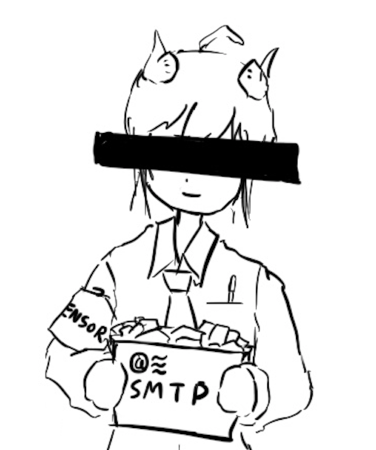
Edge Cases: Length
Cryptographic schemes are (usually) allowed to leak the length of the message
To hide length: All messages must always be the same length
16-byte messages: We can’t encrypt large messages (images, videos, etc.)!
1-GB messages: Sending small messages (text, Tweets, etc.) needs 1 GB of bandwidth!
This is unpractical
Applications that which to hide length must choose to pad their own messages to the maximum possible length before encrypting
In the IND-CPA game: M0 and M1 must be the same length
To break IND-CPA, Eve must learn something other than message length

Slide 37
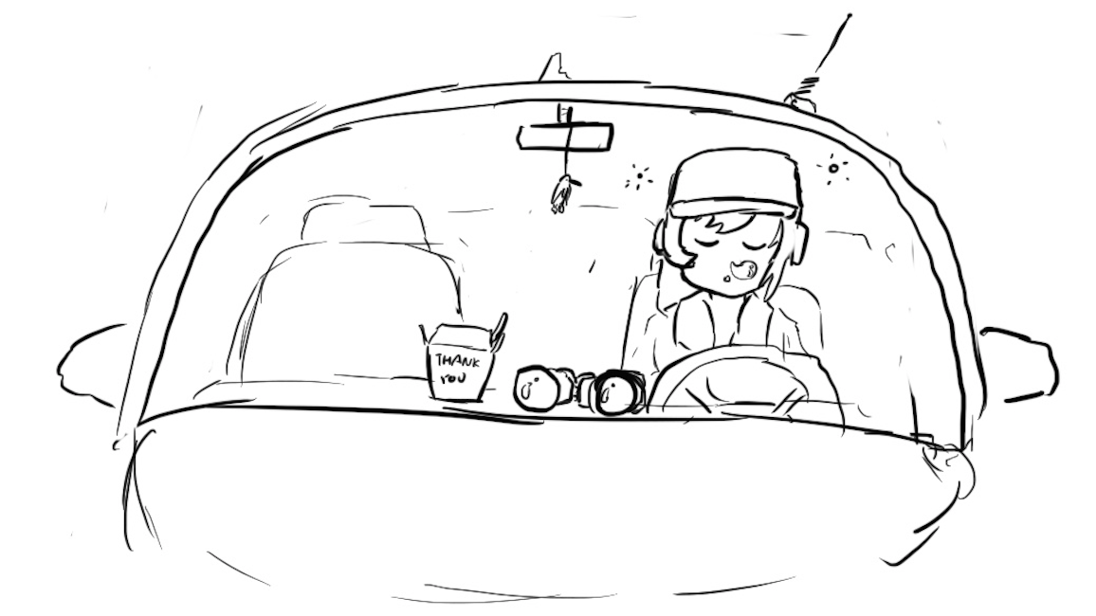
Edge Cases: Attacker Runtime
Some schemes are theoretically vulnerable, but secure in any real-world setting
If an attack takes longer than the life of the solar system to complete, it probably won’t happen!
Or if it would require a computer made out of a literal galaxy worth of science-fiction nanotech
In the IND-CPA game: Eve is limited to a practical runtime
One common practical limit: Eve is limited to polynomial runtime algorithms (no exponential-time algorithms)

Slide 38

Edge Cases: Negligible Advantage
Sometimes it’s possible for Eve to win with probability 1/2 + 1/2¹²⁸
This probability is greater than 1/2, but it's so close to 1/2 that it's as good as 1/2.
Eve's advantage is so small that she can't use it for any practical attacks
In the IND-CPA game: The scheme is secure even if Eve can win with probability ≤ 1/2 + Ɛ, where Ɛ is negligible
The actual mathematical definition of negligible is out of scope
Example: 1/2 + 1/2¹²⁸: Negligible advantage
Example: 2/3: Non-negligible advantage

Slide 39
Edge Cases: Negligible Advantage
Defining negligibility mathematically:
Advantage of the adversary should be exponentially small, based on the security parameters of the algorithm
Example: For an encryption scheme with a k-bit key, the advantage should be O(1/2^{k})
Defining negligibility practically:
A 1/2¹²⁸ probability is completely inconceivable
A 1/2²⁰ probability is fairly likely
“One in a million events happen every day in New York City”
In between these extremes, it can be messy
Different algorithms run faster or slower and have their own security parameters
Computers get more powerful over time
Recall: Know your threat model!
Takeaway: For now, 2⁸⁰ is a reasonable threshold, but this will change over time!

Slide 40

IND-CPA: Putting it together
Eve (adversary)
Alice (challenger)
Eve may choose plaintexts to send to Alice and receives their ciphertexts
Eve issues a pair of plaintexts M0 and M1 to Alice
Alice randomly chooses either M0 or M1 to encrypt and sends the encryption back
Alice does not tell Eve which one was encrypted!
Eve may again choose plaintexts to send to Alice and receives their ciphertexts
Eventually, Eve outputs a guess as to whether Alice encrypted M0 or M1
An encryption scheme is IND-CPA secure if for all polynomial time attackers Eve:
Eve can win with probability ≤ 1/2 + Ɛ, where Ɛ is negligible.
M
(repeat)
Enc(K, M)
M0 and M1
pick b
Enc(K, Mb)
M
(repeat)
Enc(K, M)
Guess b = 0 or b = 1
Notes:
Let’s stop to chew on this.

Slide 41
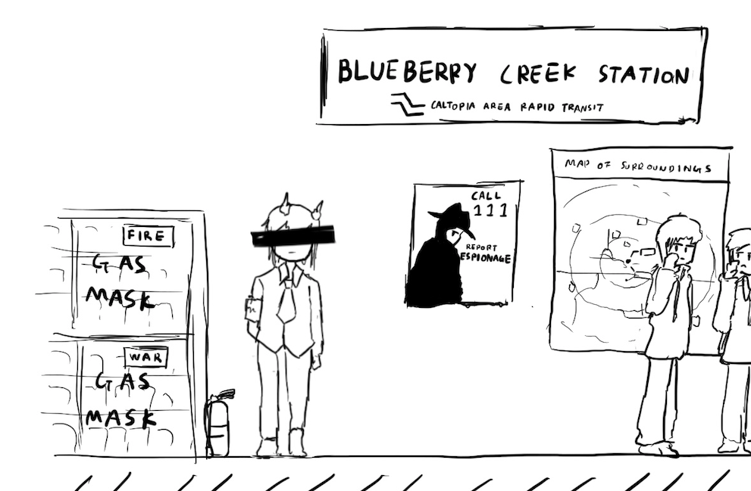
A Brief History of Cryptography
Textbook Chapter 5.2

Slide 42
Cryptography by Hand: Caesar Cipher
One of the earliest cryptographic schemes was the Caesar cipher
Used by Julius Caesar over 2,000 years ago
KeyGen():
Choose a key K randomly between 0 and 25
Enc(K, M):
Replace each letter in M with the letter K positions later in the alphabet
If K = 3, plaintext DOG becomes GRJ
Dec(K, C):
Replace each letter in C with the letter K positions earlier in the alphabet
If K = 3, ciphertext GRJ becomes DOG
K = 3
M | C | M | C
A | D | N | Q
B | E | O | R
C | F | P | S
D | G | Q | T
E | H | R | U
F | I | S | V
G | J | T | W
H | K | U | X
I | L | V | Y
J | M | W | Z
K | N | X | A
L | O | Y | B
M | P | Z | C

Slide 43
Cryptography by Hand: Attacks on the Caesar Cipher
Eve sees the ciphertext JCKN ECGUCT, but doesn’t know the key K
If you were Eve, how would you try to break this algorithm?
Brute-force attack: Try all 26 possible keys!
Use existing knowledge: Assume that the message is in English
+1 IBJM DBFTBS
+2 HAIL CAESAR
+3 GZHK BZDRZQ
+4 FYGJ AYCQYP
+5 EXFI ZXBPXO
+6 DWEH YWAOWN
+7 CVDG XVZNVM
+8 BUCF WUYMUL
+9 ATBE VTXLTK
+10 ZSAD USWKSJ
+11 YRZC TRVJRI
+12 XQYB SQUIQH
+13 WPXA RPTHPG
+14 VOWZ QOSGOF
+15 UNVY PNRFNE
+16 TMUX OMQEMD
+17 SLTW NLPDLC
+18 RKSV MKOCKB
+19 QJRU LJNBJA
+20 PIQT KIMAIZ
+21 OHPS JHLZHY
+22 NGOR IGKYGX
+23 MFNQ HFJXFW
+24 LEMP GEIWEV
+25 KDLO FDHVDU

Slide 44
Cryptography by Hand: Attacks on the Caesar Cipher
Eve sees the ciphertext JCKN ECGUCT, but doesn’t know the key K
Chosen-plaintext attack: Eve tricks Alice into encrypting plaintext of her choice
Eve sends a message M = AAA and receives C = CCC
Eve can deduce the key: C is 2 letters after A, so K = 2
Eve has the key, so she can decrypt the ciphertext

Slide 45
Cryptography by Hand: Substitution Cipher
A better cipher: create a mapping of each character to another character.
Example: A = N, B = Q, C = L, D = Z, etc.
Unlike the Caesar cipher, the shift is no longer constant!
KeyGen():
Generate a random, one-to-one mapping of characters
Enc(K, M):
Map each letter in M to the output according to the mapping K
Dec(K, C):
Map each letter in C to the output according to the reverse of the mapping K
K
M | C | M | C
A | N | N | G
B | Q | O | P
C | L | P | T
D | Z | Q | A
E | K | R | J
F | R | S | O
G | V | T | D
H | U | U | I
I | E | V | C
J | S | W | F
K | B | X | M
L | W | Y | X
M | Y | Z | H

Slide 46
Cryptography by Hand: Attacks on Substitution Ciphers
Does the brute-force attack still work?
There are 26! ≈ 2⁸⁸ possible mappings to try
Too much for most modern computers… for now
How about the chosen-plaintext attack?
Trick Alice into encrypting ABCDEFGHIJKLMNOPQRSTUVWXYZ, and you’ll get the whole mapping!
Another strategy: cryptanalysis
The most common english letters in text are E, T, A, O, I, N
K
M | C | M | C
A | N | N | G
B | Q | O | P
C | L | P | T
D | Z | Q | A
E | K | R | J
F | R | S | O
G | V | T | D
H | U | U | I
I | E | V | C
J | S | W | F
K | B | X | M
L | W | Y | X
M | Y | Z | H

Slide 47
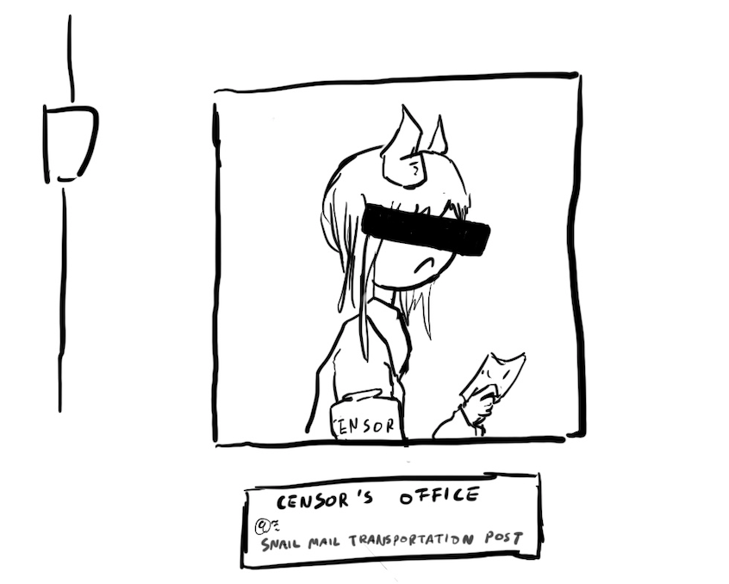
Takeaways
Cryptography started with paper-and-pencil algorithms (Caesar cipher)
Then cryptography moved to machines (Enigma)
Finally, cryptography moved to computers (which we’re about to study)
Hopefully you gained some intuition for some of the cryptographic definitions

Slide 48
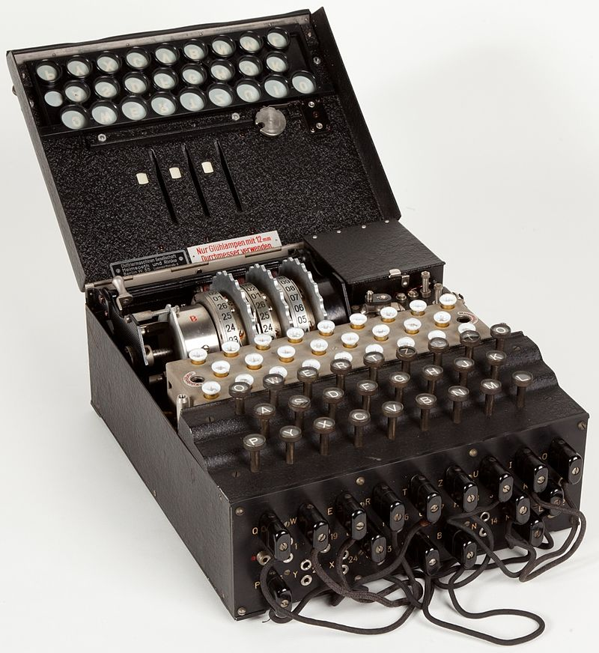

Cryptography by Machines: Enigma
A mechanical encryption machine used by the Germans in WWII
Rotors
Plugboard

Slide 49
Enigma Operating Principle: Rotor Machine
The encryption core was composed of 3 or 4 rotors
Each rotor was a fixed permutation (e.g. A maps to F, B maps to Q...)
And the end was a "reflector", a rotor that sent things backwards
Plus a fixed-permutation plugboard
A series of rotors were arranged in a sequence
Each keypress would generate a current from the input to one light for the output
Each keypress also advanced the first rotor
When the first rotor makes a full rotation, the second rotor advances one step
When the second rotor makes a full rotation, the third rotor advances once step

Slide 50
Cryptography by Machines: Enigma
KeyGen():
Choose rotors, rotor orders, rotor positions, and plugboard settings
158,962,555,217,826,360,000 possible keys
Enc(K, M) and Dec(K, C):
Input the rotor settings K into the Enigma machine
Press each letter in the input, and the lampboard will light up the corresponding output letter
Encryption and decryption are the same algorithm!
Germans believed that Enigma was an “unbreakable code”

Slide 51
Cryptography by Machines: Enigma
Eve (adversary)
Alice (challenger)
Enigma has a significant weakness: a letter never maps to itself!
No rotor maps a letter to itself
The reflector never maps a letter to itself
This property is necessary for Enigma’s mechanical system to work
What pair of messages should Eve send to Alice in the challenge phase?
Send M0 = A^{k}, M1 = B^{k}
M0 is a string of k 'A' characters, M1 is a string of k 'B' characters
How can Eve probably know which message Alice encrypted?
If there are no 'A' characters, it was M0
If there are no 'B' characters, it was M1
M
(repeat)
Enc(K, M)
M0 and M1
pick b
Enc(K, Mb)
M
(repeat)
Enc(K, M)
Guess b = 0 or b = 1

Slide 52
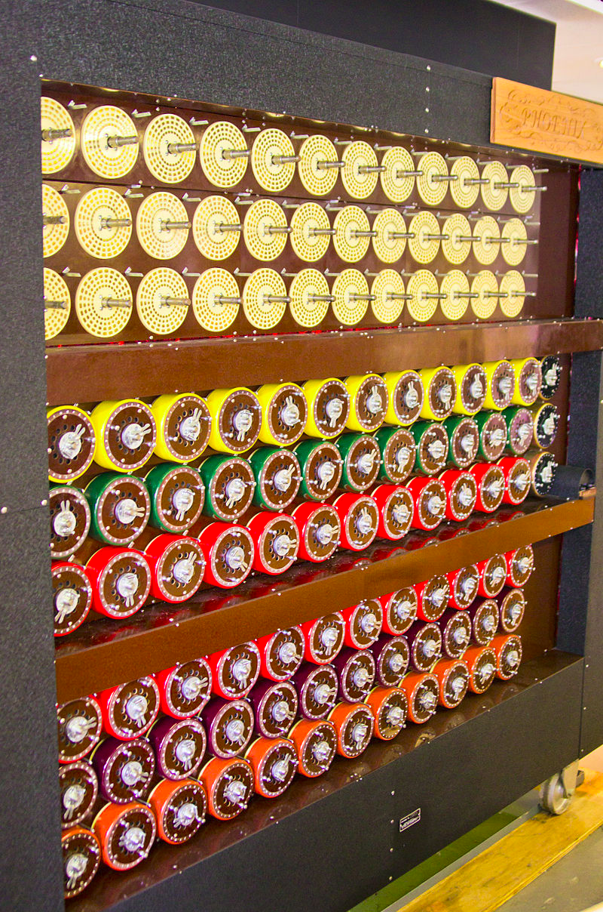
Cryptography by Machines: Attack on Enigma
Polish and British cryptographers built BOMBE, a machine to brute-force Enigma keys
Why was Enigma breakable?
Kerckhoff’s principle: The Allies stole Enigma machines, so they knew the algorithm
Known plaintext attacks: the Germans often sent predictable messages (e.g. the weather report every morning)
Chosen plaintext attacks: the Allies could trick the Germans into sending a message (e.g. “newly deployed minefield”)
Brute-force: BOMBE would try many keys until the correct one was found
Plus a weakness: You'd be able to try multiple keys with the same hardware configuration
BOMBE machine

Slide 53

Cryptography by Machines: Legacy of Enigma
Alan Turing, one of the cryptographers who broke Enigma, would go on to become one of the founding fathers of computer science
Most experts agree that the Allies breaking Enigma shortened the war in Europe by about a year
Alan Turing

Slide 54


Cryptography by Computers
The modern era of cryptography started after WWII, with the work of Claude Shannon
“New Directions in Cryptography” (1976) showed how number theory can be used in cryptography
Its authors, Whitfield Diffie and Martin Hellman, won the Turing Award in 2015 for this paper
This is the era of cryptography we’ll be focusing on
One of these is Diffie, and the other one is Hellman.

Slide 55
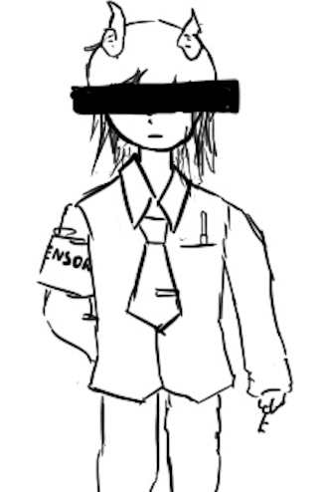
One-Time Pads
Textbook Chapter 6.2 & 6.3

Slide 56
Cryptography Roadmap
 | Symmetric-key | Asymmetric-key
Confidentiality | One-time pads Block ciphers with chaining modes (e.g. AES-CBC) Stream ciphers | RSA encryption ElGamal encryption
Integrity, Authentication | MACs (e.g. HMAC) | Digital signatures (e.g. RSA signatures)
Hash functions
Pseudorandom number generators
Public key exchange (e.g. Diffie-Hellman)
Key management (certificates)
Password management

Slide 57
Review: XOR
The XOR operator takes two bits and outputs one bit:
Useful properties of XOR:
0 ⊕ 0 = 0
0 ⊕ 1 = 1
1 ⊕ 0 = 1
1 ⊕ 1 = 0
x ⊕ 0 = x
x ⊕ x = 0
x ⊕ y = y ⊕ x
(x ⊕ y) ⊕ z = x ⊕ (y ⊕ z)
(x ⊕ y) ⊕ x = y

Slide 58
Review: XOR Algebra
Algebra works on XOR too
y ⊕ 1 = 0 | Goal: Solve for y
y ⊕ 1 ⊕ 1 = 0 ⊕ 1 | XOR both sides by 1
y = 1 | Simplify with identities

Slide 59
One-Time Pads: Key Generation
Alice
K
0 | 1 | 1 | 0 | 0 | 1 | 0 | 1 | 0 | 1 | 1 | 1
The key K is a randomly-chosen bitstring.
Recall: We are in the symmetric-key setting, so we’ll assume Alice and Bob both know this key.

Slide 60
One-Time Pads: Encryption
Alice
K
0 | 1 | 1 | 0 | 0 | 1 | 0 | 1 | 0 | 1 | 1 | 1
M
1 | 0 | 0 | 1 | 1 | 0 | 0 | 1 | 0 | 1 | 0 | 0
The plaintext M is the bitstring that Alice wants to encrypt.
Idea: Use XOR to scramble up M with the bits of K.

Slide 61
One-Time Pads: Encryption
Alice
K
0 | 1 | 1 | 0 | 0 | 1 | 0 | 1 | 0 | 1 | 1 | 1
⊕ | ⊕ | ⊕ | ⊕ | ⊕ | ⊕ | ⊕ | ⊕ | ⊕ | ⊕ | ⊕ | ⊕
M
1 | 0 | 0 | 1 | 1 | 0 | 0 | 1 | 0 | 1 | 0 | 0
↓ | ↓ | ↓ | ↓ | ↓ | ↓ | ↓ | ↓ | ↓ | ↓ | ↓ | ↓
C
1 | 1 | 1 | 1 | 1 | 1 | 0 | 0 | 0 | 0 | 1 | 1
Encryption algorithm: XOR each bit of K with the matching bit in M.
The ciphertext C is the encrypted bitstring that Alice sends to Bob over the insecure channel.

Slide 62
One-Time Pads: Decryption
Bob
K
0 | 1 | 1 | 0 | 0 | 1 | 0 | 1 | 0 | 1 | 1 | 1
C
1 | 1 | 1 | 1 | 1 | 1 | 0 | 0 | 0 | 0 | 1 | 1
Bob receives the ciphertext C. Bob knows the key K. How does Bob recover M?

Slide 63
One-Time Pads: Decryption
Bob
K
0 | 1 | 1 | 0 | 0 | 1 | 0 | 1 | 0 | 1 | 1 | 1
⊕ | ⊕ | ⊕ | ⊕ | ⊕ | ⊕ | ⊕ | ⊕ | ⊕ | ⊕ | ⊕ | ⊕
C
1 | 1 | 1 | 1 | 1 | 1 | 0 | 0 | 0 | 0 | 1 | 1
↓ | ↓ | ↓ | ↓ | ↓ | ↓ | ↓ | ↓ | ↓ | ↓ | ↓ | ↓
M
1 | 0 | 0 | 1 | 1 | 0 | 0 | 1 | 0 | 1 | 0 | 0
Decryption algorithm: XOR each bit of K with the matching bit in C.

Slide 64
One-Time Pad
KeyGen()
Randomly generate an n-bit key, where n is the length of your message
Recall: For today, we assume that Alice and Bob can securely share this key
For one-time pads, we generate a new key for every message
Enc(K, M) = K ⊕ M
Bitwise XOR M and K to produce C
In other words: XOR the ith bit of the plaintext with the ith bit of the key.
Ci = Ki ⊕ Mi
Alice and Bob use a different key for each encryption (this is the “one-time” in one-time pad).
Dec(K, C) = K ⊕ C
Bitwise XOR C and K to produce M
Mi = Ki ⊕ Ci
Notes:
Ask students if they can produce the decryption equation before showing it to them

Slide 65
One-Time Pad: Correctness
Correctness: If we encrypt and then decrypt, we should get the original message back
Enc(K, M) | = | K ⊕ M | Definition of encryption
Dec(K, Enc(K, M)) | = | Dec(K, K ⊕ M) | Decrypting the ciphertext
 | = | K ⊕ (K ⊕ M) | Definition of decryption
 | = | M | XOR property

Slide 66
One-Time Pad: Security
Recall our definition of confidentiality: The ciphertext should not give the attacker any additional information about the plaintext
Recall our experiment to test confidentiality from earlier:
Alice has encrypted and sent either M0 or M1
Eve knows either M0 or M1 was sent, but doesn't know which
Eve reads the ciphertext and tries to guess which message was sent
If the probability that Eve correctly guesses which message was sent is 1/2, then the encryption scheme is confidential

Slide 67
One-Time Pad: Security
Possibility 0: Alice sends Enc(K, M0)
Possibility 1: Alice sends Enc(K, M1)
The ciphertext is C = K ⊕ M0
Therefore, K = C ⊕ M0
The ciphertext is C = K ⊕ M1
Therefore, K = C ⊕ M1
K was chosen randomly, so both possibilities are equally possible
Eve has learned no new information, so the scheme is perfectly secure

Slide 68
Two-Time Pads?
Alice
K
Insecure Channel
M0
OTP Enc
K ⊕ M0
Eve sees two ciphertexts over the insecure channel.
K
M1
OTP Enc
K ⊕ M1
What if we use the same key K to encrypt two different messages?

Slide 69
Two-Time Pads?
Alice
K
Insecure Channel
Eve
M0
OTP Enc
K ⊕ M0
(K ⊕ M0) ⊕ (K ⊕ M1) = M0 ⊕ M1
K
⊕
M1
OTP Enc
K ⊕ M1
If Eve XORs the two ciphertexts, she learns M0 ⊕ M1!

Slide 70
Two-Time Pads?
What if we use the same key twice?
Alice encrypts M0 and M1 with the same key
Eve observes K ⊕ M0 and K ⊕ M1
Eve computes (K ⊕ M0) ⊕ (K ⊕ M1) = M0 ⊕ M1
Recall the XOR property: the K's cancel out
Eve has learned M0 ⊕ M1. This is partial information about the messages!
In words, Eve knows which bits in M0 match bits in M1
If Eve knows M0, she can deduce M1 (and vice-versa)
Eve can also guess M0 and check that M1 matches her guess for M0
Result: One-time pads are not secure if the key is reused
Alice and Bob must use a different key for every message!

Slide 71
Impracticality of One-Time Pads
Problem #1: Key generation
For security to hold, keys must be randomly generated for every message, and never reused
Randomness is expensive, as we’ll see later
Problem #2: Key distribution
To communicate an n-bit message, we need to securely communicate an n-bit key first
But if we have a way to securely communicate an n-bit key, we could have communicated the message directly!
Only practical application: Communicate keys in advance
You have a secure channel now, but you won’t have it later
Use the secure channel now to communicate keys in advance
Use one-time pad later to communicate over the insecure channel
And people can compute this by hand without computers!

Slide 72
One-Time Pads in Practice: Spies
At home base, the spy obtains a large amount of key material (e.g. a book of random bits)
In the field, the spy listens for secret messages from their home country
There are shortwave and terrestrial radio “number stations”
At a regular time, a voice gets on the air and reads a series of numbers
If you don’t know the key, this looks like a meaningless sequence of random numbers
If you know the key, you can decrypt the spy message!
What if you don’t want to send anything to any spies?
Read out a list of random numbers anyway
Because one-time pad leaks no information, an eavesdropper can’t distinguish between an encrypted message and random numbers!

Slide 73
Two-Time Pads in Practice: VENONA
Soviet spies used one-time pads for communication from their spies in the US
During WWII, the Soviets started reusing key material
Uncertain whether it was just the cost of generating pads or what…
VENONA was a US cryptanalysis project designed to break these messages
Included confirming/identifying the spies targeting the US Manhattan project
Project continued until 1980!
Not declassified until 1995!
So secret even President Truman wasn’t informed about it
The Soviets found out about it in 1949 through their spy Ken Philby, but their one-time pad reuse was fixed after 1948 anyway
Takeaway: Otherwise-secure cryptographic systems can fail very badly if used improperly!
Notes:
TODO Nick

Slide 74
Summary
What’s cryptography?
Communicating securely over insecure channels
You should never write your own crypto! Use existing libraries instead.
Definitions
Alice and Bob want to send messages over an insecure channel. Eve can read anything sent over the insecure channel. Mallory can read or modify anything sent over the insecure channel.
We want to ensure confidentiality (adversary can’t read message), integrity (adversary can’t modify message), and authenticity (prove message came from sender)
Crypto uses secret keys. Kerckhoff’s principle says to assume the attacker knows the entire system, except the secret keys.
There are several different threat models. We’ll focus on the chosen plaintext attack, where Eve tricks Alice into encrypting some messages.

Slide 75
Summary
IND-CPA security
Even if Eve can trick Alice into encrypting some messages of Eve’s choosing, given the encryption of either M0 or M1, Eve cannot distinguish which message was sent with probability greater than 1/2.
We can use the IND-CPA game to test for IND-CPA security
Edge cases: IND-CPA secure schemes can leak length. Eve is limited to polynomial-time algorithms, and must have a non-negligible advantage to win.
One-time pads
Symmetric encryption scheme: Alice and Bob share a secret key.
Encryption and decryption: Bitwise XOR with the key.
No information leakage if the key is never reused.
Information leaks if the key is reused.
Impractical for real-world usage, unless you’re a spy.

